Slide 1

Shell Bootcamp 2024 3 Reflections for Week #1
Nayan Khemka
Date : 30-Aug-2024

Slide 2

About Me
Life is what you make it so let’s make it rock

Slide 3

My learnings from this week!

Slide 4
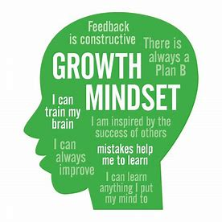
Learning 1 | My takeaways
Professionalism and Growth Mindset
Interpersonal Relationship management
C2C (Campus to corporate transition)
Rapport building
Collaboration with team
Plan, organize, write, edit, review for self assessment
Professional qualities
Self discipline

Slide 5
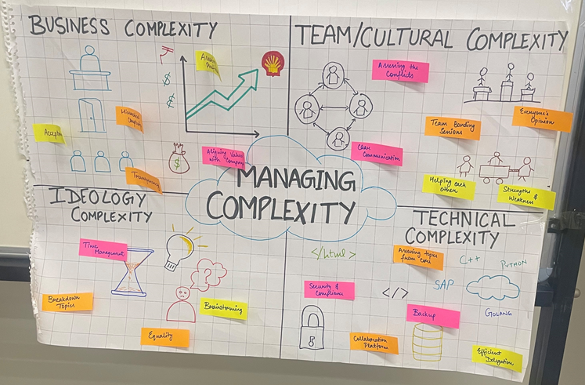
Learning 2 | My takeaways
Teamwork and Presentation
Good attitude and mindset
Mobile, meeting, email, group etiquettes
Stakeholder
Inform, monitor, satisfy, collab and manage closely
Stakeholder expectations
Dedication

Slide 6
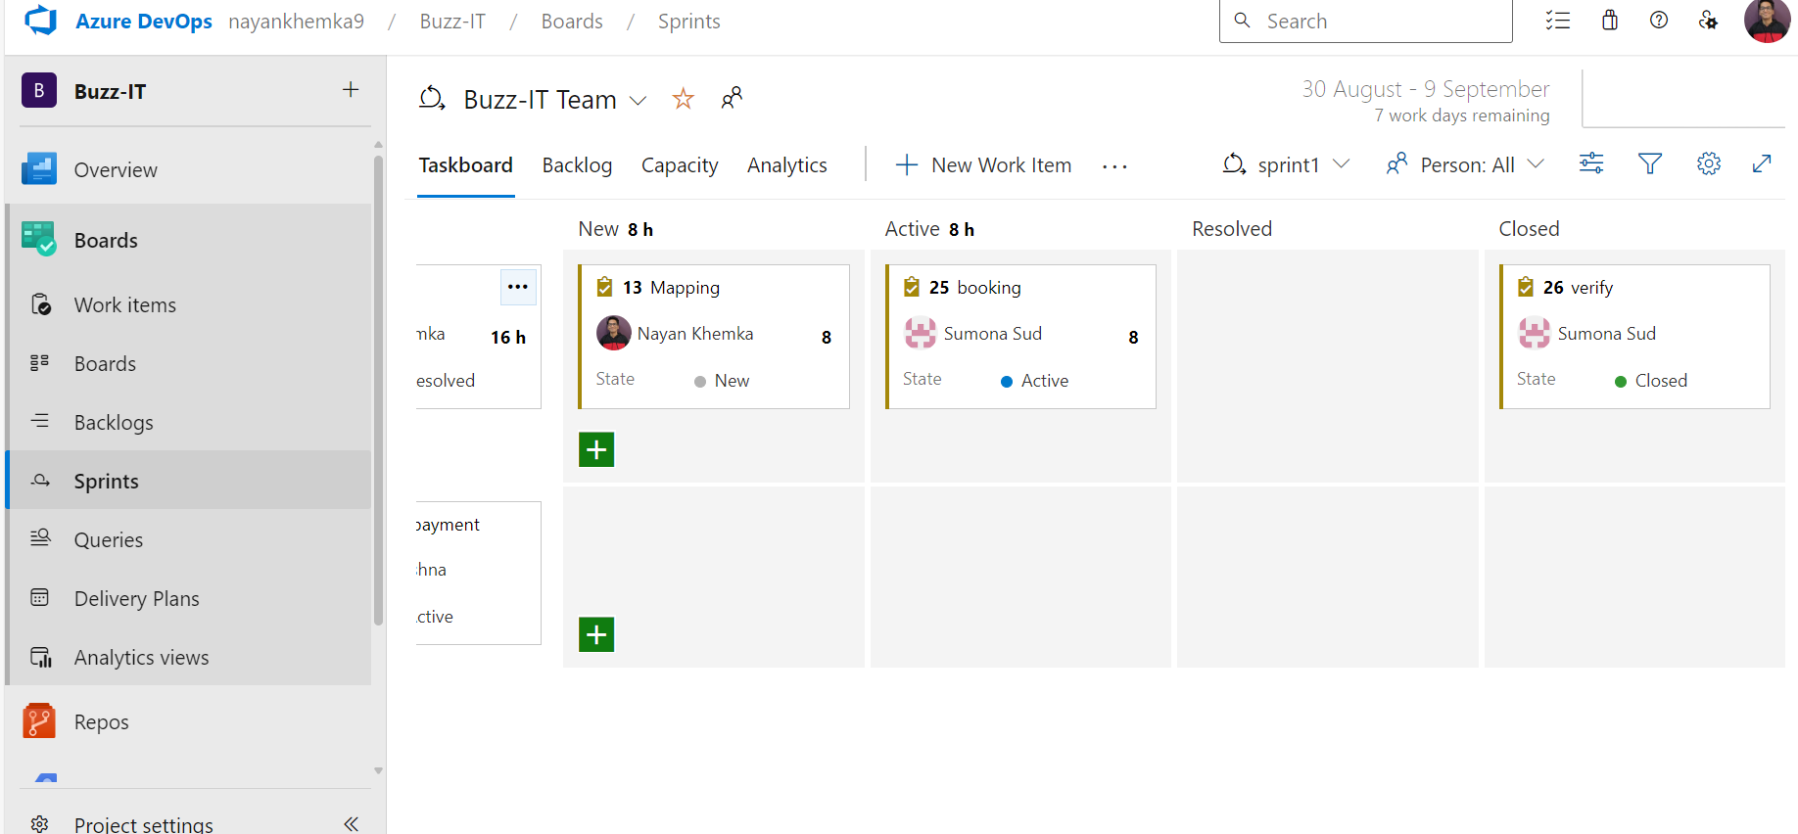
Learning 3 | My takeaways
Business Analysis and Agile
Business Analysis and Scope
Stakeholders
Requirement Analysis
Waterfall Model
Agile models
Gantt charts, WBS and aspects of scrum
Azure Devops
[

Slide 7

Relevance of learnings for my organization

Slide 8
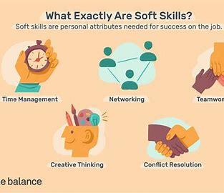
Learning 1 | Relevance for Shell
Soft skills such as organization, leadership, communication, and problem-solving enhance efficiency for both the company and its employees.
This is particularly crucial for Shell, where networking and technical skills are highly valued. These abilities enable employees to be more productive and consistently meet or surpass standards and deadlines.

Slide 9
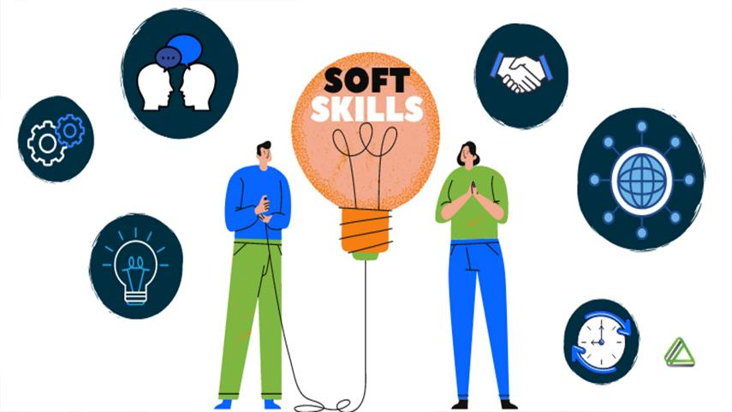
Learning 2 | Relevance for Shell
By promoting effective communication, soft skills encourage creative problem-solving and cultivate a sense of professional camaraderie, thereby boosting our company’s productivity. In the absence of soft skills, teams and departments may face challenges such as communication breakdowns, conflicts, and inefficiency.

Slide 10
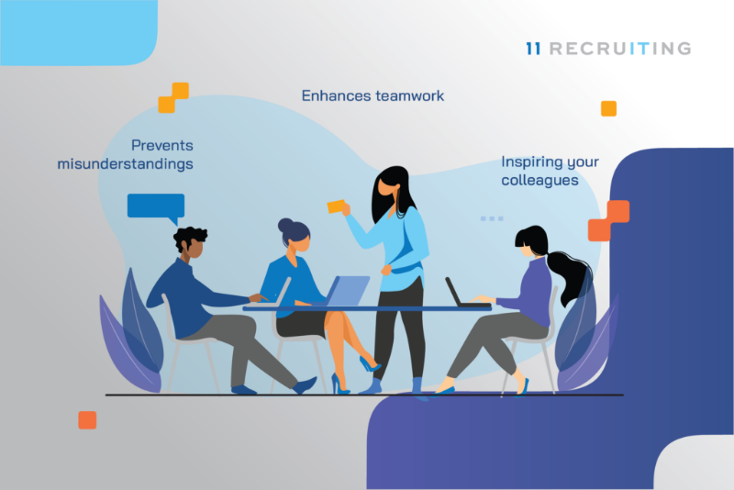
Learning 3 | Relevance for Shell
Business Analysis (BA) benefitted us in a lot many things with respect to shell. We now can-do informed decision making, greater revenue can be generated because of it, operational efficiency increases as there won’t be constant breaks once everything is decided in the most proper way possible. Iterative set of activities that help ensure that elicitation, documentation, refinement, and changes of requirements is adequately dealt with during a lifecycle. Reduces cost, improves quality, decreases time taken, decreases risks. Superior quality product, customer satisfaction, better control, improved project predictability, reduced risks, increased flexibility, continuous improvement are some benefits from AGILE.
[Add a graphic that provides view of how Shell implements this learning]

Slide 11

Challenges in implementing learning

Slide 12
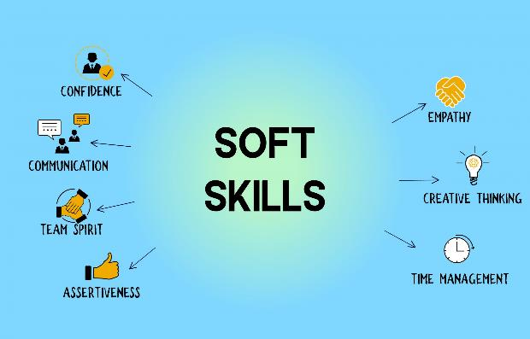
Challenge faced while implementing Learning 1
No challenges faced specially for the soft-skills class because every learning was depicted properly and moreover, we played skits and did role play to understand how things work. We might not have got best at it but did get good gist of it.
[Add a graphic that provides evidence of what you did to overcome this challenge]

Slide 13

Challenge faced while implementing Learning 2
Teamwork could’ve been a little problem when arranged with certain people as they might be rigid and not so welcoming sometimes but that can also be overcome.
[Add a graphic that provides evidence of what you did to overcome this challenge]

Slide 14
Challenge faced while implementing Learning 3
Learning Business Analysis (BA) and Agile methodologies was challenging due to the need for rapid adaptation and effective communication. This bootcamp helped by providing hands-on experience, improving teamwork, and offering practical exercises that enhanced my skills and confidence in managing Agile projects.
GitHub link of your solution/documentation
nayan-khemka/BootCamp: This is a repository for an energy monitoring system created within the Training Bootcamp by Unext in shell (github.com)

Slide 15

Action Plan

Slide 16
My Action Plan for this Week
Actions
Timeline
Status
Practice and explore the resources available for the same.
Saturday: Teamwork and Co-ordination exercises with colleagues
Sunday: Explore Azure Devops
Actively Learning

Slide 17

Learning is also Fun!

Slide 18
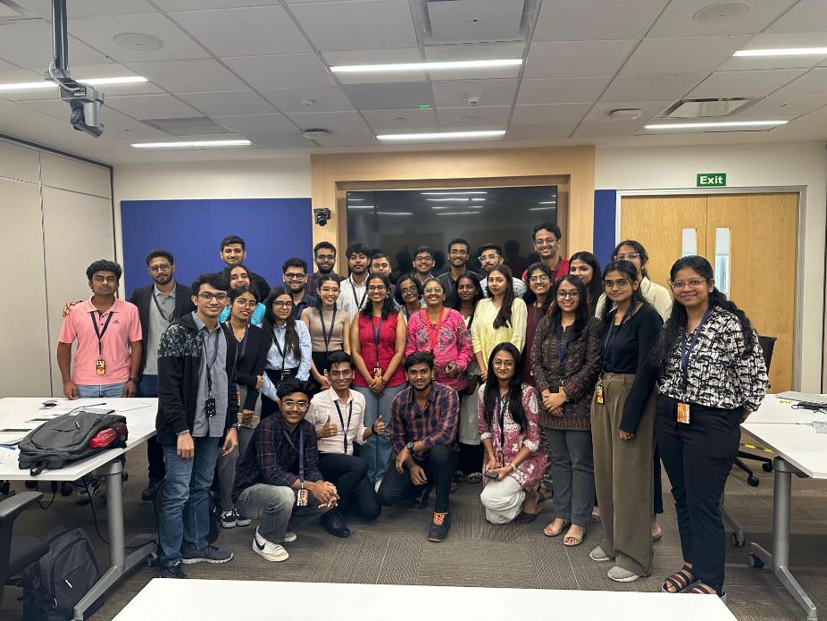
Learning is also Fun!
Enjoyed doing short presentations in teams and bonding with people over creativity and commonalities.
It was interesting to collaborate on Azure Project and learning together as well

Slide 19

Summary
Learned soft-skills, BA & agile
Will revise DBMS learned from college
Software setup is needed.

Slide 20
Thank You

